Slide 1
Fibonacci Heap
Ref: CLRS 2nd edition and 3rd edition
Prepared by
Preetom Saha Arko

Slide 2
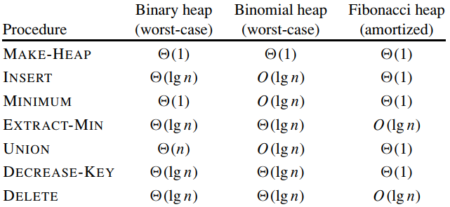
Comparison of Runtime

Slide 3
When To Use Fibonacci Heaps
Fibonacci heaps are especially desirable when the number of EXTRACT-MIN and DELETE operations is small relative to the number of other operations performed.
For example, some algorithms for graph problems may call DECREASE-KEY once per edge. For dense graphs, which have many edges, the O(1) amortized time of each call of DECREASE-KEY adds up to a big improvement over the Θ(lg n) worst-case time of binary or binomial heaps.
From a practical point of view, however, the constant factors and programming complexity of Fibonacci heaps make them less desirable than ordinary binary (or k-ary) heaps for most applications.
Thus, Fibonacci heaps are predominantly of theoretical interest.

Slide 4
Binomial Heap vs Fibonacci Heap
Like a binomial heap, a Fibonacci heap is a collection of trees.
Fibonacci heaps, in fact, are loosely based on binomial heaps.
If neither DECREASE-KEY nor DELETE is ever invoked on a Fibonacci heap, each tree in the heap is like a binomial tree.
Fibonacci heaps have a more relaxed structure than binomial heaps, however, allowing for improved asymptotic time bounds.
Work that maintains the structure can be delayed until it is convenient to perform.
Like binomial heaps, Fibonacci heaps are not designed to give efficient support to the operation SEARCH.

Slide 5
Fibonacci Heap
Like a binomial heap, a Fibonacci heap is a collection of min-heap-ordered trees.
The trees in a Fibonacci heap are not constrained to be binomial trees, however.
Unlike trees within binomial heaps, which are ordered, trees within Fibonacci heaps are rooted but unordered.

Slide 6
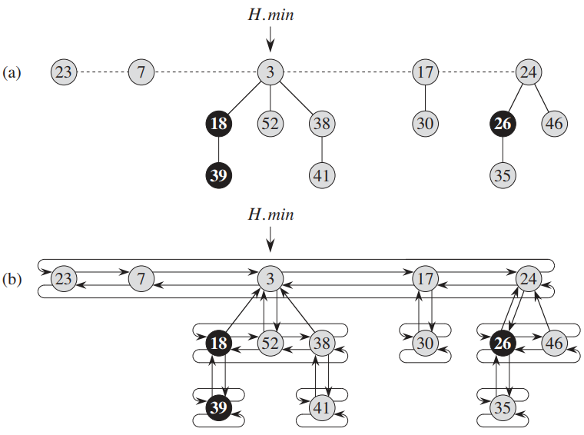
Fibonacci Heap (contd.)
Each node x contains a pointer x.p to its parent and a pointer x.child to any one of its children.
The children of x are linked together in a circular, doubly linked list, which we call the child list of x.
Each child y in a child list has pointers y.left and y.right that point to y’s left and right siblings, respectively.
If node y is an only child, then y.left = y.right = y .
The order in which siblings appear in a child list is arbitrary.

Slide 7
Circular, Doubly Linked Lists… Why?
Circular, doubly linked lists have two advantages for use in Fibonacci heaps.
First, we can remove a node from a circular, doubly linked list in O(1) time.
Second, given two such lists, we can concatenate them into one circular, doubly linked list in O(1) time.

Slide 8
Some Fields of A Node
x.degree
The number of children in the child list of node x is stored in x.degree .
x.mark
- The boolean-valued field x.mark indicates whether node x has lost a child since the last time x was made the child of another node.
- Newly created nodes are unmarked, and a node x becomes unmarked whenever it is made the child of another node. Until we look at the DECREASE-KEY operation, we will just set all mark fields to FALSE.

Slide 9
Roots and Number of Nodes
A given Fibonacci heap H is accessed by a pointer H.min to the root of a tree containing a minimum key; this node is called the minimum node of the Fibonacci heap.
If a Fibonacci heap H is empty, then H.min = NIL.
The roots of all the trees in a Fibonacci heap are linked together using their left and right pointers into a circular, doubly linked list called the root list of the Fibonacci heap.
The order of the trees within a root list is arbitrary.
The number of nodes currently in H is kept in H.n .

Slide 10
Amortized Analysis
In an amortized analysis, the time required to perform a sequence of data-structure operations is averaged over all the operations performed.
Amortized analysis can be used to show that the average cost of an operation is small, if one averages over a sequence of operations, even though a single operation within the sequence might be expensive.
Amortized analysis differs from average-case analysis in that probability is not involved; an amortized analysis guarantees the average performance of each operation in the worst case.

Slide 11
Three Methods of Amortized Analysis
Aggregate Method
Accounting Method
Potential Method

Slide 12
Potential Method of Amortized Analysis
The potential method of amortized analysis represents the prepaid work as “potential energy,” or just “potential,” that can be released to pay for future operations.
The potential is associated with the data structure as a whole rather than with specific objects within the data structure.

Slide 13
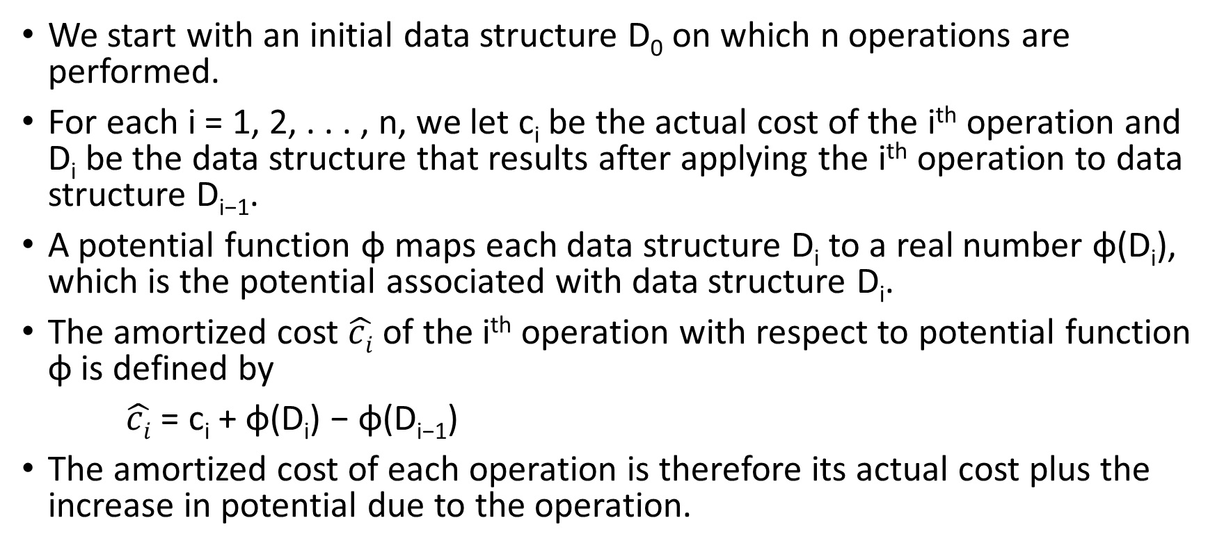
Potential Method of Amortized Analysis (contd.)
We start with an initial data structure D₀ on which n operations are performed.
For each i = 1, 2, . . . , n, we let c_{i} be the actual cost of the i^{th} operation and D_{i} be the data structure that results after applying the i^{th} operation to data structure D_{i−1}.
A potential function φ maps each data structure D_{i} to a real number φ(D_{i}), which is the potential associated with data structure D_{i}.
The amortized cost $\hat{ci}$ of the i^{th} operation with respect to potential function φ is defined by
$\hat{ci}$ = c_{i} + φ(D_{i}) − φ(D_{i−1})
The amortized cost of each operation is therefore its actual cost plus the increase in potential due to the operation.

Slide 14
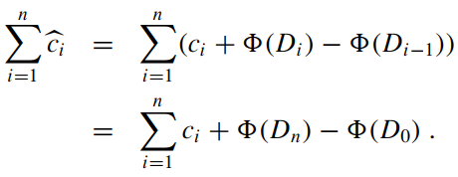

Potential Method of Amortized Analysis (contd.)
The total amortized cost of the n operations is
If we can define a potential function φ so that φ(D_{n}) ≥ φ(D₀), then the total amortized cost $\sum_{i=1}^{n}{\hat{ci}}$ is an upper bound on the total actual cost $\sum_{i=1}^{n}{\text{c}\text{i}}$.

Slide 15
Potential Method of Amortized Analysis (contd.)
In practice, we do not always know how many operations might be performed. Therefore, if we require that φ(D_{i}) ≥ φ(D₀) for all i, then we guarantee that we pay in advance.
It is often convenient to define φ(D₀) to be 0 and then to show that φ(D_{i}) ≥ 0 for all i.

Slide 16
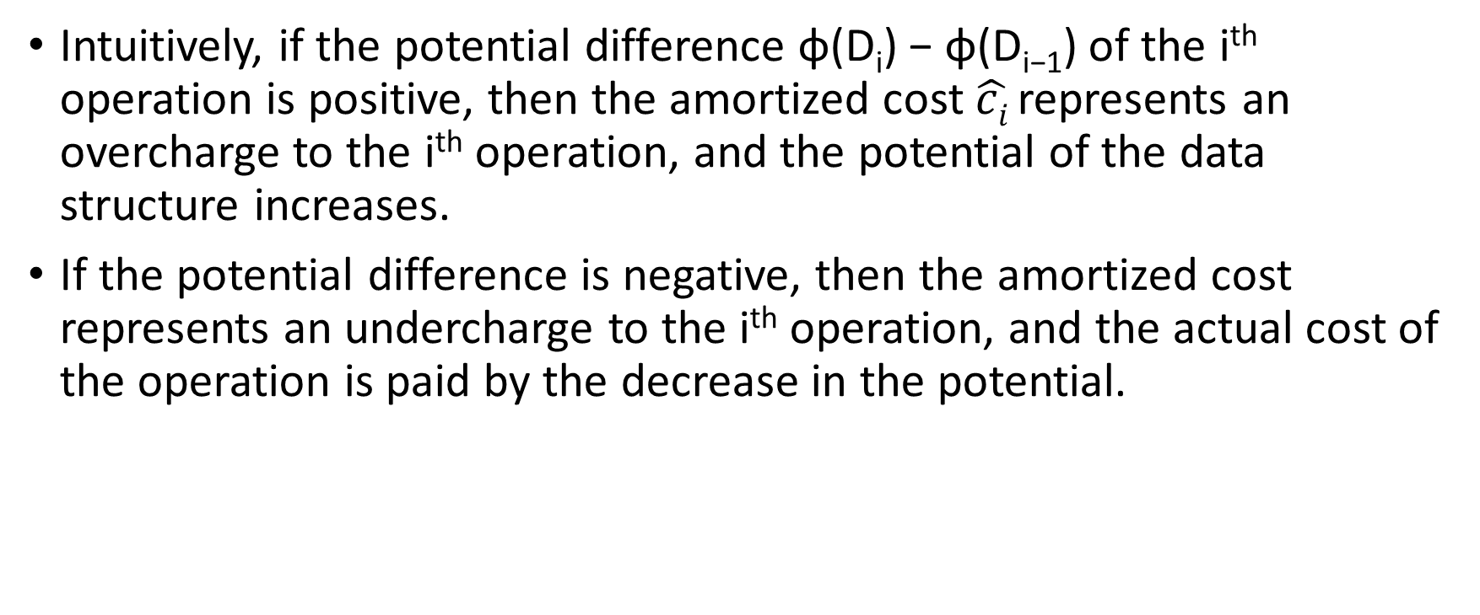
Potential Method of Amortized Analysis (contd.)
Intuitively, if the potential difference φ(D_{i}) − φ(D_{i−1}) of the i^{th} operation is positive, then the amortized cost $\hat{ci}$represents an overcharge to the i^{th} operation, and the potential of the data structure increases.
If the potential difference is negative, then the amortized cost represents an undercharge to the i^{th} operation, and the actual cost of the operation is paid by the decrease in the potential.

Slide 17
Potential Method of Amortized Analysis (contd.)
The amortized costs depend on the choice of the potential function φ.
Different potential functions may yield different amortized costs yet still be upper bounds on the actual costs.
There are often trade-offs that can be made in choosing a potential function; the best potential function to use depends on the desired time bounds.

Slide 18
Amortized Runtime Analysis for Insertion to Dynamic Array
https://courses.cs.duke.edu/spring19/compsci330/lecture21scribe.pdf
Here φ(x_{i+1}) - φ(x_{i}) has been used instead of φ(D_{i}) − φ(D_{i−1})
(In the 2nd table of page 4, capacity for x_{i+1} should be 2^{k+1} instead of 2^{k+1}+1)
Observe that φ(x_{i+1}) - φ(x_{i}) is positive for simple insertions and negative for costly insertions. Thus the potential stored in simple insertions later compensate for costly insertions.

Slide 19
Potential Function for Fibonacci Heap
For a given Fibonacci heap H, we indicate by t(H) the number of trees in the root list of H and by m(H) the number of marked nodes in H.
The potential of Fibonacci heap H is then defined by
φ(H) = t(H) + 2m(H)
The potential of a set of Fibonacci heaps is the sum of the potentials of its constituent Fibonacci heaps.
We assume that a Fibonacci heap application begins with no heaps.
The initial potential, therefore, is 0, and the potential is nonnegative at all subsequent times.
So, an upper bound on the total amortized cost is thus an upper bound on the total actual cost for the sequence of operations.
The key idea in the mergeable-heap operations on Fibonacci heaps is to delay work as long as possible.

Slide 20
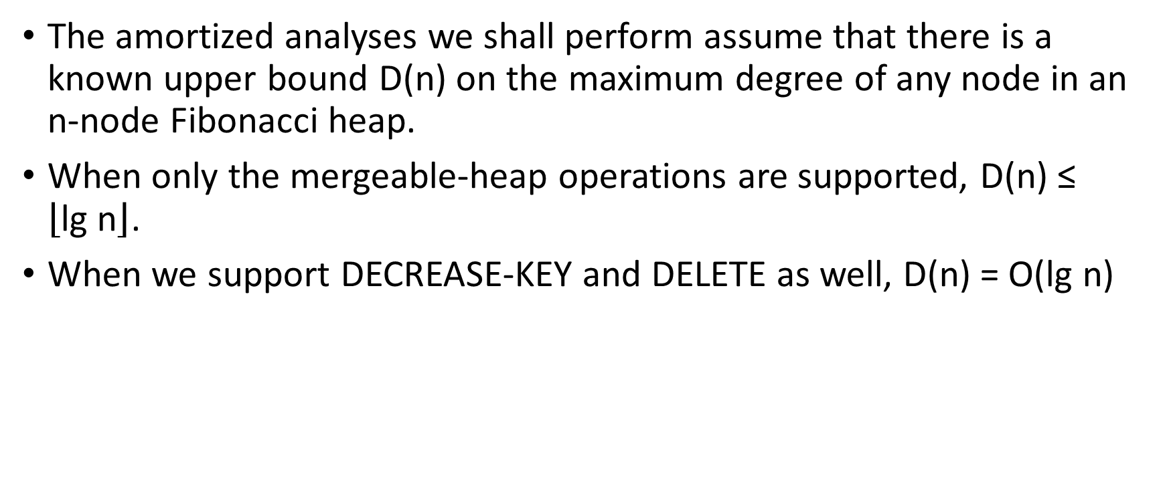
Upper Bound on the Maximum Degree
The amortized analyses we shall perform assume that there is a known upper bound D(n) on the maximum degree of any node in an n-node Fibonacci heap.
When only the mergeable-heap operations are supported, D(n) ≤ $\left\lfloor \text{lg} \text{n}\right\rfloor$.
When we support DECREASE-KEY and DELETE as well, D(n) = O(lg n)

Slide 21
Unordered Binomial Tree
If only these operations—MAKE-HEAP, INSERT, MINIMUM, EXTRACT-MIN, and UNION—are to be supported, each Fibonacci heap is simply a collection of “unordered” binomial trees.
An unordered binomial tree is like a binomial tree, and it, too, is defined recursively.
The unordered binomial tree U₀ consists of a single node, and an unordered binomial tree U_{k} consists of two unordered binomial trees U_{k−1} for which the root of one is made into any child of the root of the other.

Slide 22
Unordered Binomial Tree (contd.)
For the unordered binomial tree U_{k}, the root has degree k, which is greater than that of any other node. The children of the root are roots of subtrees U₀, U₁, . . . , U_{k−1} in some order.
If an n-node Fibonacci heap is a collection of unordered binomial trees, then D(n) = lg n.

Slide 23
Creating a New Fibonacci Heap
To make an empty Fibonacci heap, the MAKE-FIB-HEAP procedure allocates and returns the Fibonacci heap object H, where H.n = 0 and H.min = NIL; there are no trees in H.
Because t(H) = 0 and m(H) = 0, the potential of the empty Fibonacci heap is φ(H) = 0.
The amortized cost of MAKE-FIB-HEAP is thus equal to its O(1) actual cost.

Slide 24
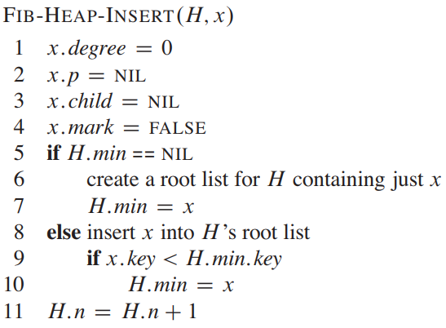
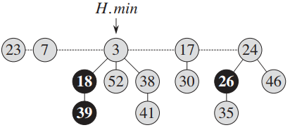
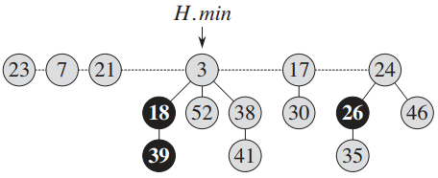
Inserting A Node

Slide 25
Inserting A Node (contd.)
Unlike the BINOMIAL-HEAP-INSERT procedure, FIB-HEAP-INSERT makes no attempt to consolidate the trees within the Fibonacci heap.
If k consecutive FIBHEAP-INSERT operations occur, then k single-node trees are added to the root list.
To determine the amortized cost of FIB-HEAP-INSERT, let H be the input Fibonacci heap and H’ be the resulting Fibonacci heap.
Then, t(H’) = t(H)+1 and m(H’) = m(H), and the increase in potential is
((t(H) + 1) + 2m(H)) − (t(H) + 2m(H)) = 1 .
Since the actual cost is O(1), the amortized cost is O(1) + 1 = O(1).

Slide 26
Finding the Minimum Node
The minimum node of a Fibonacci heap H is given by the pointer H.min, so we can find the minimum node in O(1) actual time.
Because the potential of H does not change, the amortized cost of this operation is equal to its O(1) actual cost.

Slide 27
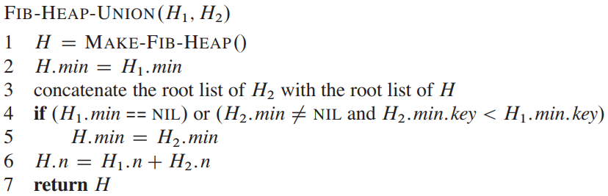
Uniting Two Fibonacci Heaps
It simply concatenates the root lists of H₁ and H₂ and then determines the new minimum node. No consolidation of trees occurs.

Slide 28
Amortized Cost of FIB-HEAP-UNION
The change in potential is
φ(H) − (φ(H₁) + φ(H₂))
= (t(H) + 2m(H)) − ((t(H₁) + 2m(H₁)) + (t(H₂) + 2m(H₂)))
= 0
because t(H) = t(H₁) + t(H₂) and m(H) = m(H₁) + m(H₂).
The amortized cost of FIB-HEAP-UNION is therefore equal to its O(1) actual cost.

Slide 29
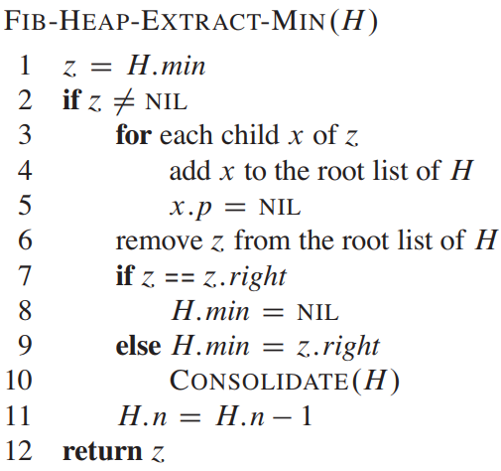
Extracting the Minimum Node
The delayed work of consolidating trees in the root list finally occurs here.

Slide 30
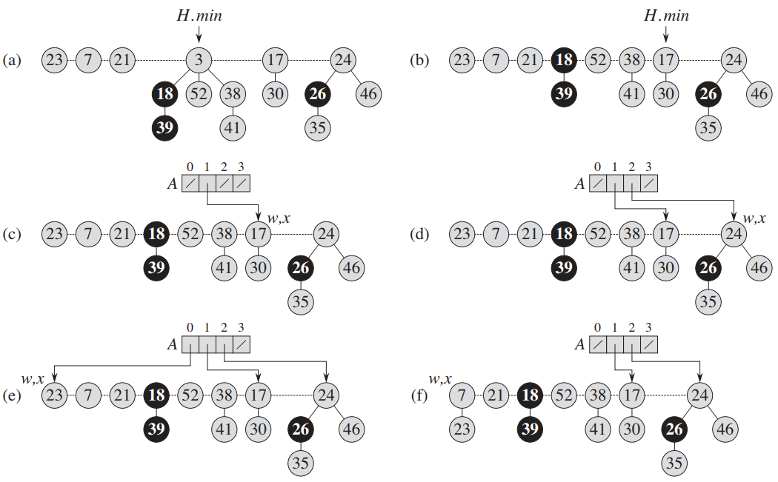
Extract-Min

Slide 31
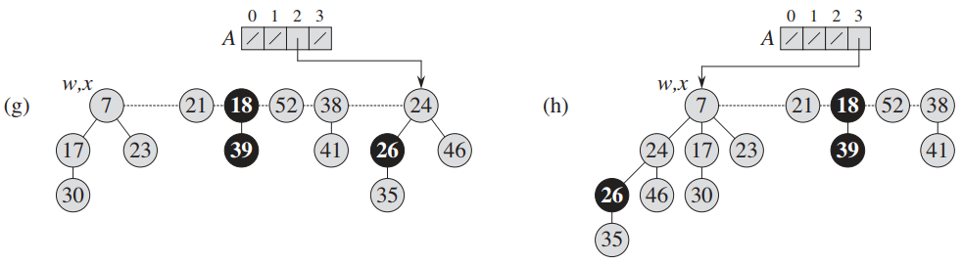
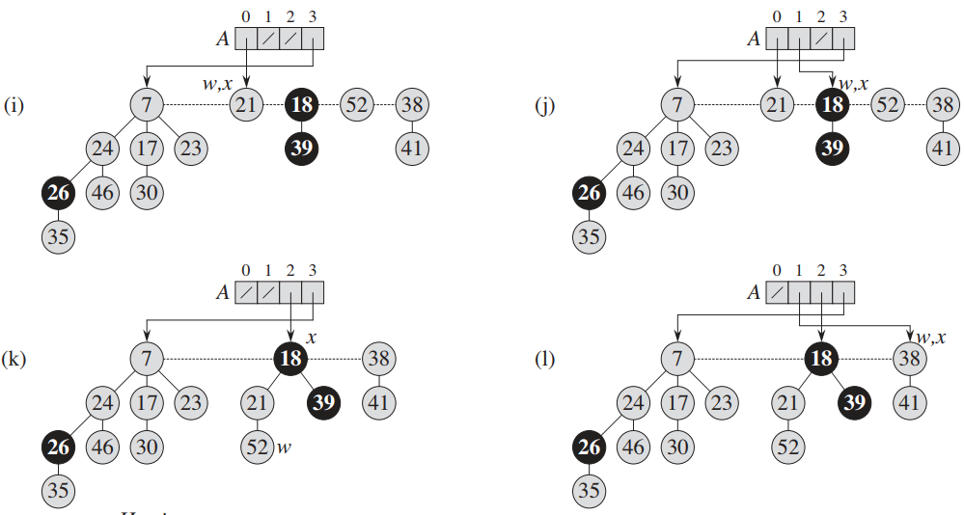
Extract-Min (contd.)

Slide 32
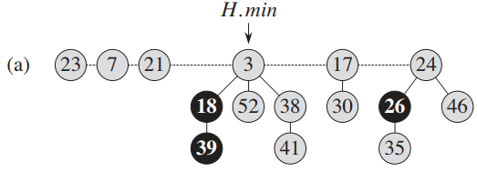
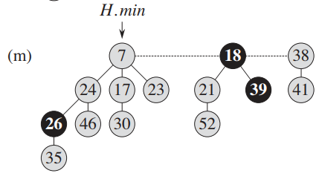
Resulting Heap from Extract-Min

Slide 33
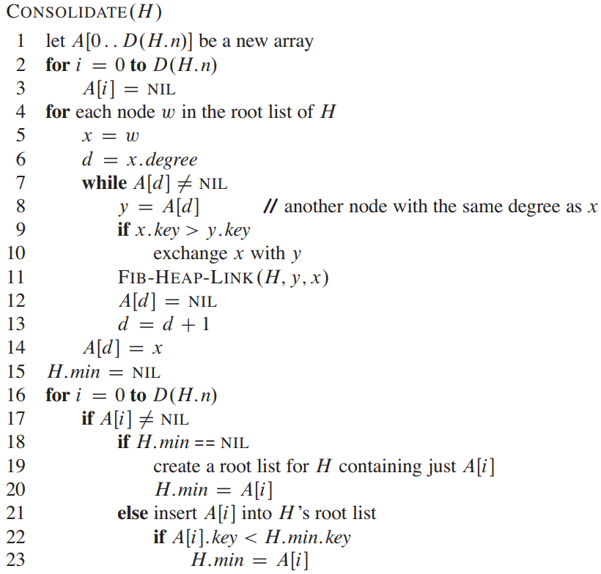
Consolidate

Slide 34
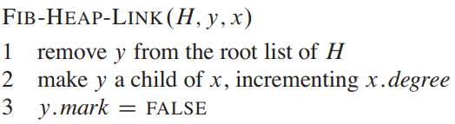
FIB-HEAP-LINK

Slide 35
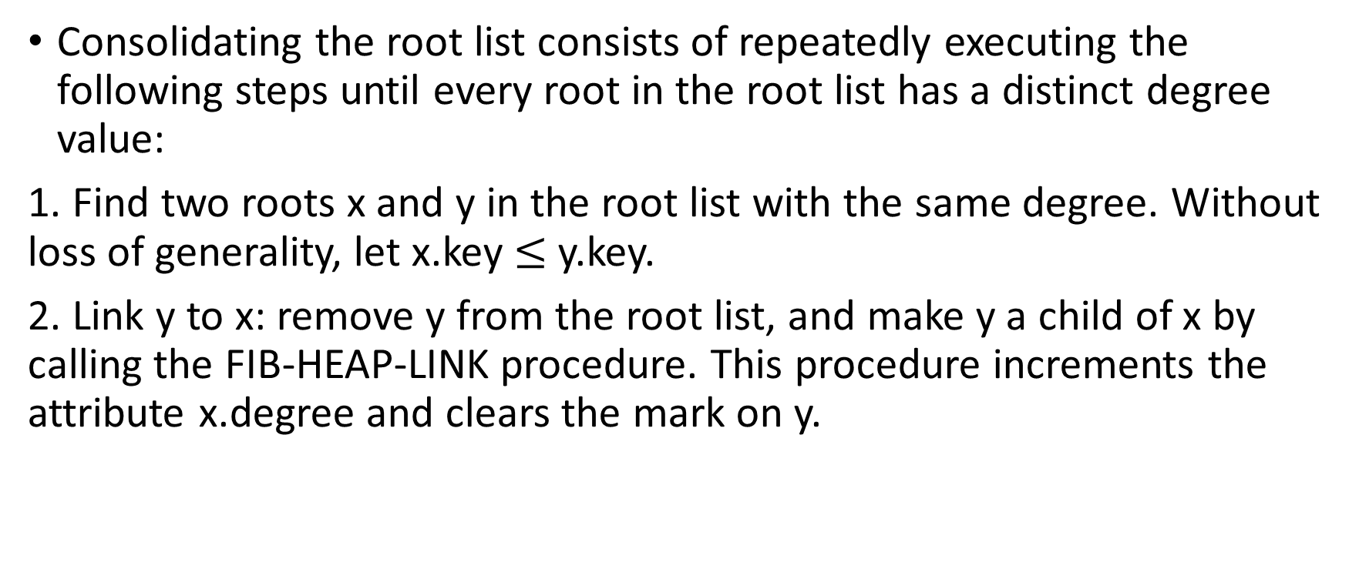
Consolidate
Consolidating the root list consists of repeatedly executing the following steps until every root in the root list has a distinct degree value:
1. Find two roots x and y in the root list with the same degree. Without loss of generality, let x.key $≤$ y.key.
2. Link y to x: remove y from the root list, and make y a child of x by calling the FIB-HEAP-LINK procedure. This procedure increments the attribute x.degree and clears the mark on y.

Slide 36
Auxiliary Array A
The procedure CONSOLIDATE uses an auxiliary array A[0 .. D(H.n)] to keep track of roots according to their degrees.
If A[i] = y, then y is currently a root with y.degree = i.
Of course, in order to allocate the array, we have to know how to calculate the upper bound D(H.n) on the maximum degree.

Slide 37
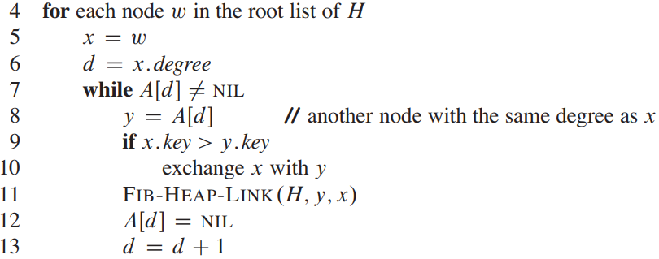
Fixing The Trees
When this for loop terminates, at most one root of each degree will remain, and the array A will point to each remaining root.
At the start of each iteration of the while loop, d = x.degree .

Slide 38
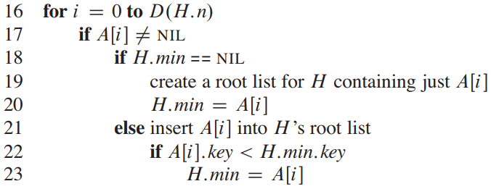
Setting Up Root List and H.min

Slide 39


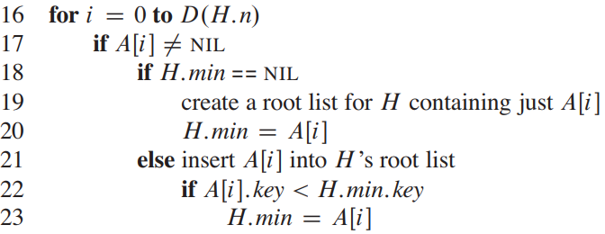
Amortized Cost of EXTRACT-MIN
The amortized cost of extracting the minimum node of an n-node Fibonacci heap is O(D(n)).
An O(D(n)) contribution comes from
FIB-HEAP-EXTRACT-MIN processing at most D(n) children of the minimum node
setting all A[i] to NIL at the beginning (CONSOLIDATE)
cleaning up at last (CONSOLIDATE)

Slide 40
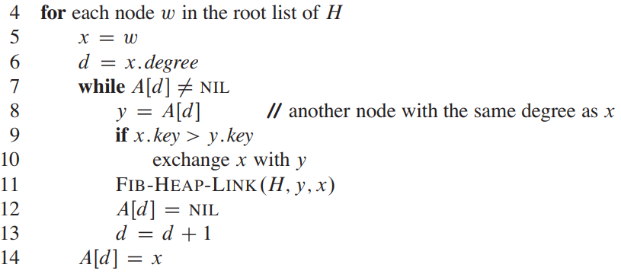
Actual Cost of Extract-Min
The size of the root list upon calling CONSOLIDATE is at most D(n) + t(H) – 1
Every time through the while loop, one of the roots is linked to another, and thus the total number of iterations of the while loop over all iterations of the for loop is at most the number of roots in the root list.
So the total actual work in extracting the minimum node is O(D(n) + t(H)).

Slide 41
Amortized Cost of Extract-Min
The potential before extracting the minimum node is t(H)+2m(H), and the potential afterward is at most (D(n)+1) + 2m(H), since at most D(n)+1 roots remain and no nodes become marked during the operation. (the number of marked nodes may decrease because of FIB-HEAP-LINK operation but won’t increase for sure)
The amortized cost is thus at most
O(D(n)+t(H)) + (D(n)+1+2m(H)) – (t(H)+2m(H))
= O(D(n)) + O(t(H)) - t(H) = O(D(n))
since we can scale up the units of potential to dominate the constant hidden in O(t(H)).
Intuitively, the cost of performing each link is paid for by the reduction in potential due to the link’s reducing the number of roots by one.

Slide 42
Some Variation of EXTRACT-MIN
In some implementations of Fibonacci Heap, mark fields of all the children of the extracted min node are cleared when those children are added to the root list. (This happens before CONSOLIDATE)
In that case, the line
y.mark=FALSE
in FIB-HEAP-LINK operation can be omitted as FIB-HEAP-LINK will never find any marked node to link. (think, why?)
This approach is similar to the DECREASE-KEY operation.
Many Fibonacci Heap simulators (such as https://people.ksp.sk/~kuko/gnarley-trees/Fibonacci.html ) use this approach.

Slide 43
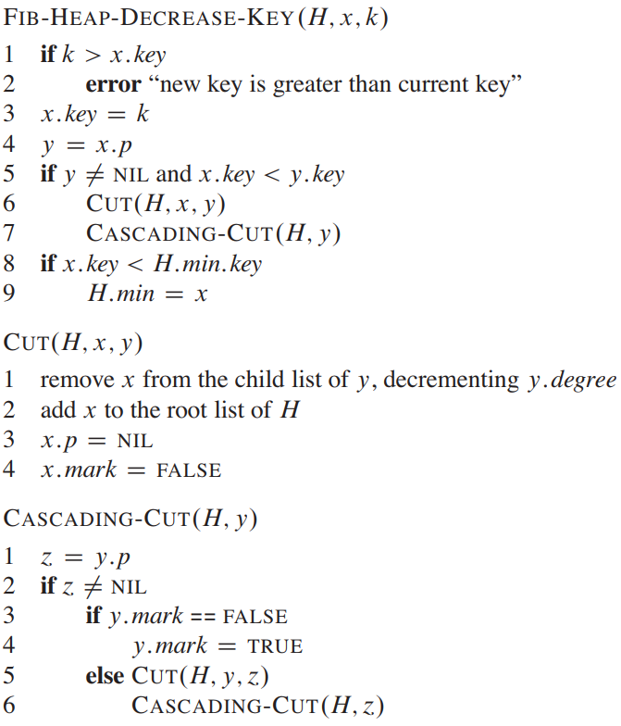
Decreasing A Key

Slide 44
CUT and “mark” attribute
The CUT procedure “cuts” the link between x and its parent y, making x a root.
We use the mark attributes to obtain the desired time bounds.
They record a little piece of the history of each node.
x.mark
- The boolean-valued field x.mark indicates whether node x has lost a child since the last time x was made the child of another node.
- Newly created nodes are unmarked, and a node x becomes unmarked whenever it is made the child of another node.

Slide 45
mark attribute
Suppose that the following events have happened to a node x:
1. at some time, x was a root,
2. then x was linked to (made the child of) another node,
3. then two children of x were removed by cuts.
As soon as the second child has been lost, we cut x from its parent, making it a new root. -> clears x.mark

Slide 46
CUT and CASCADING-CUT
x might be the second child cut from its parent y since the time that y was linked to another node.
Therefore, we attempt to perform a cascading-cut operation on y.
If y is a root, then just return.
If y is unmarked, the procedure marks it, since its first child has just been cut, and returns.
If y is marked, however, it has just lost its second child; y is cut, and CASCADING-CUT calls itself recursively on y’s parent z.
The CASCADING-CUT procedure recurses its way up the tree until it finds either a root or an unmarked node.

Slide 47
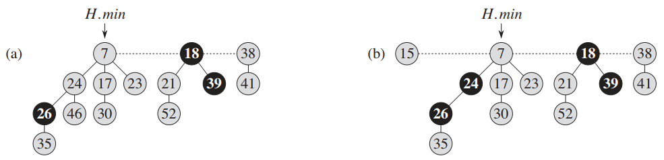
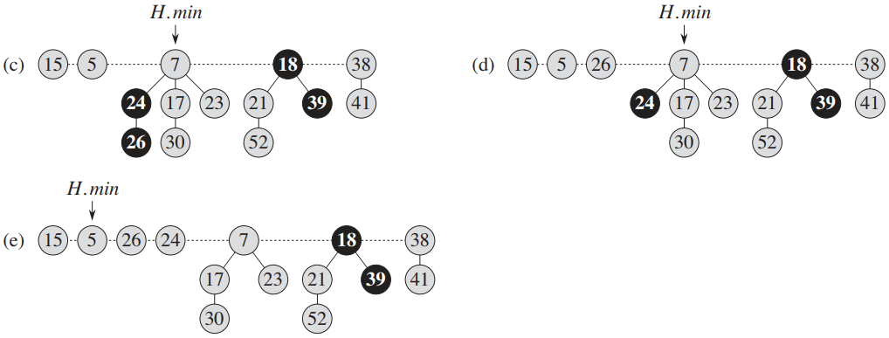
Decreasing A Key - Example
Decrease to 15
Decrease to 5

Slide 48
Amortized Cost Analysis of FIB-HEAP-DECREASE-KEY
The FIB-HEAP-DECREASE-KEY procedure takes O(1) time, plus the time to perform the cascading cuts.
Suppose that a given invocation of FIB-HEAP-DECREASE-KEY results in c calls of CASCADING-CUT (the call made from FIB-HEAP-DECREASE-KEY followed by c-1 recursive calls of CASCADING-CUT).
Each call of CASCADING-CUT takes O(1) time exclusive of recursive calls.
Thus, the actual cost of FIB-HEAP-DECREASE-KEY, including all recursive calls, is O(c).

Slide 49
Change in Potential
The call to CUT in FIB-HEAP-DECREASE-KEY creates a new tree rooted at node x and clears x’s mark bit (which may have already been FALSE).
Each call of CASCADING-CUT, except for the last one, cuts a marked node and clears the mark bit.
Afterward, the Fibonacci heap contains
t(H)+c trees
the original t(H) trees, c-1 trees produced by cascading cuts, and the tree rooted at x
at most m(H)-c+2 marked nodes
c-1 were unmarked by cascading cuts and the last call of CASCADING-CUT may have marked a node.

Slide 50
Amortized Cost of FIB-HEAP-DECREASE-KEY
The change in potential is therefore at most
(t(H)+c) + 2(m(H)-c+2) - (t(H) + 2m(H)) = 4 - c
Thus, the amortized cost of FIB-HEAP-DECREASE-KEY is at most
O(c) + 4 - c = O(1)
since we can scale up the units of potential to dominate the constant hidden in O(c).
When a marked node y is cut by a cascading cut, its mark bit is cleared, which reduces the potential by 2.
One unit of potential pays for the cut and the clearing of the mark bit, and the other unit compensates for the unit increase in potential due to node y becoming a root. -> that’s why t(H) + 2m(H)

Slide 51
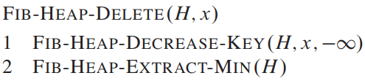
Deleting A Node
The amortized time of FIB-HEAP-DELETE is the sum of the O(1) amortized time of FIB-HEAP-DECREASE-KEY and the O(D(n)) amortized time of FIB-HEAP-EXTRACT-MIN.
Since D(n) = O(lg n), the amortized time of FIB-HEAP-DELETE is O(lg n)

Slide 52
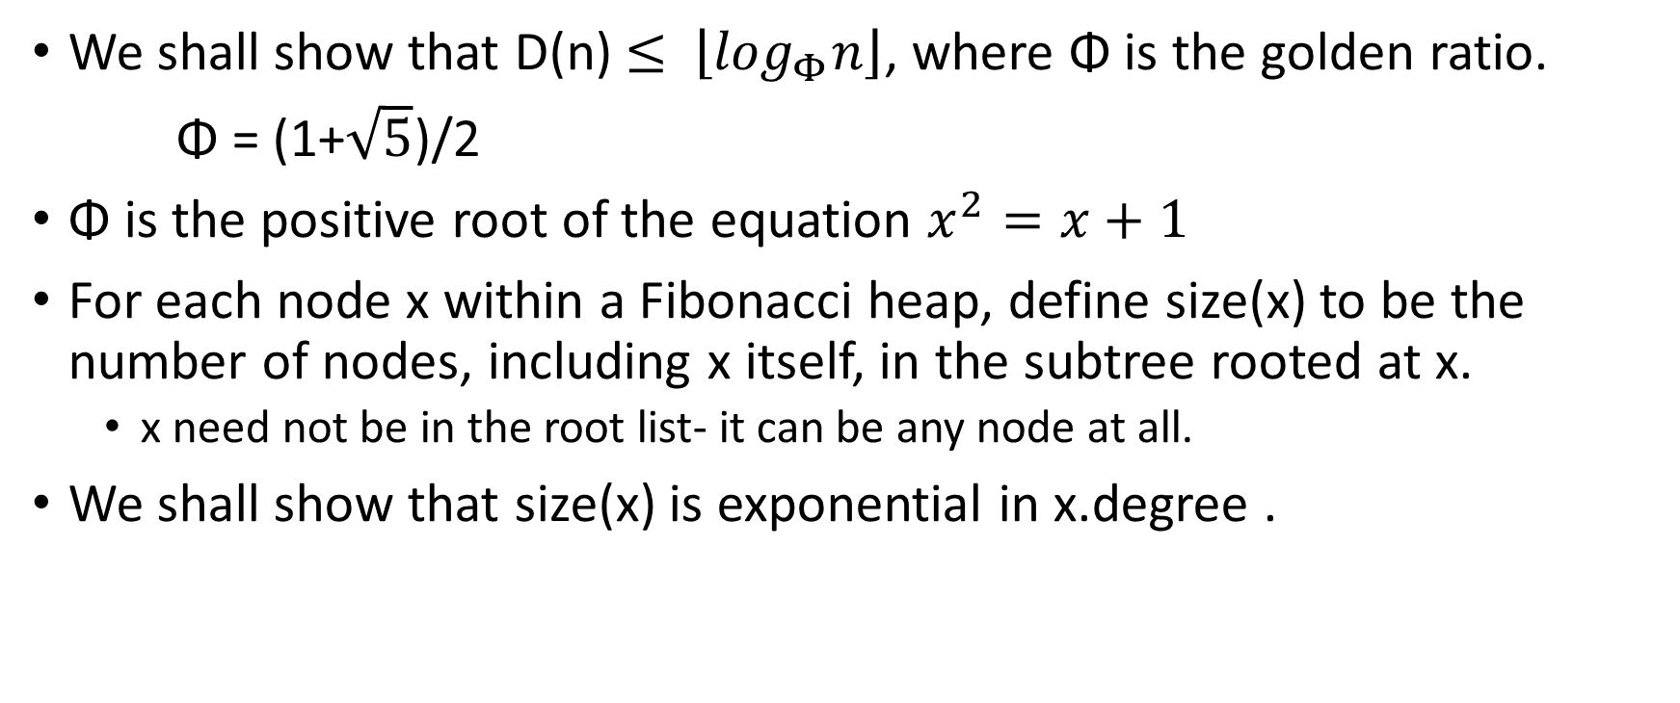
Bounding The Maximum Degree
We shall show that D(n) $≤$ $\left\lfloor \log_{Φ}n\right\rfloor$, where Φ is the golden ratio.
Φ = (1+$\sqrt{5}$)/2
Φ is the positive root of the equation $x^{2}=x+1$
For each node x within a Fibonacci heap, define size(x) to be the number of nodes, including x itself, in the subtree rooted at x.
x need not be in the root list- it can be any node at all.
We shall show that size(x) is exponential in x.degree .

Slide 53
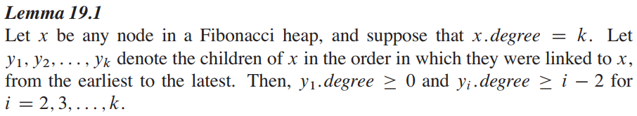
Lower Bound on Degree

Slide 54
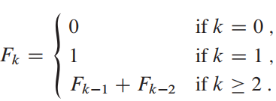
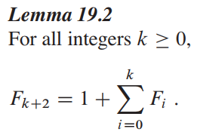
Fibonacci Number
for k = 0, 1, 2, … , the kth Fibonacci number is defined by the recurrence

Slide 55
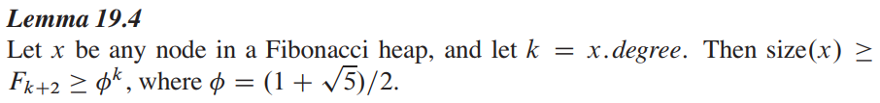
Relationship Between Fibonacci Number and Fibonacci Heap
Corollary 19.5
The maximum degree D(n) of any node in an n-node Fibonacci heap is O(lg n)

Slide 56
Fibonacci Heap and Relaxed Heap
Original paper on Fibonacci Heap (Fredman and Tarjan) also describes the application of Fibonacci heaps to the problems of single-source shortest paths, all-pairs shortest paths, weighted bipartite matching, and the minimum-spanning tree problem.
Subsequently, Driscoll, Gabow, Shrairman, and Tarjan developed “relaxed heaps” as an alternative to Fibonacci heaps. They devised two varieties of relaxed heaps.
One gives the same amortized time bounds as Fibonacci heaps.
The other allows DECREASE-KEY to run in O(1) worst-case (not amortized) time and EXTRACT-MIN and DELETE to run in O(lg n) worst-case time.
Relaxed heaps also have some advantages over Fibonacci heaps in parallel algorithms.

Slide 57
Fibonacci Heap Visualization Tool
https://people.ksp.sk/~kuko/gnarley-trees/Fibonacci.html

